Slide 1
Deploying an Aurelia App

Slide 2
Deploying an Aurelia App
Update any URI’s that refer to the server port to make sure if refers to the server port
Move references to local CSS files to app.html
Build the app using either au run or au build
Copy the contents of the client scripts folder into a folder called scripts in the public folder of your server
Copy the index.html file into the public folder of you server

Slide 3
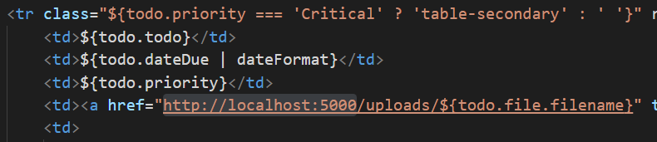
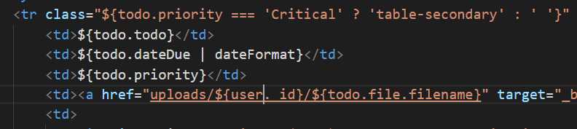
Update any URI’s that refer to the server port to make sure if refers to the server port
Change this in the todoList table…
…to this

Slide 4
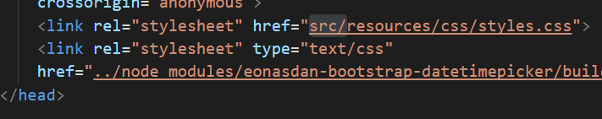
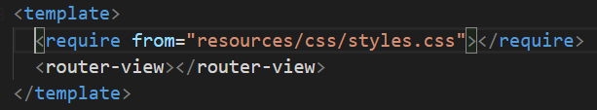
Move references to local CSS files to app.html
Remove this from index.html
Add this to app.html

Slide 5
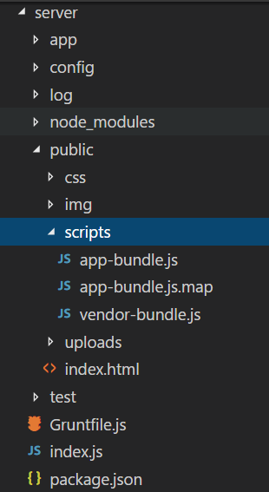
Copy the contents of the client scripts folder into a folder called scripts in the public folder of your server
Every time you change the client application, you have to copy the script files to the server and then refresh the application in the browser

